Slide 1
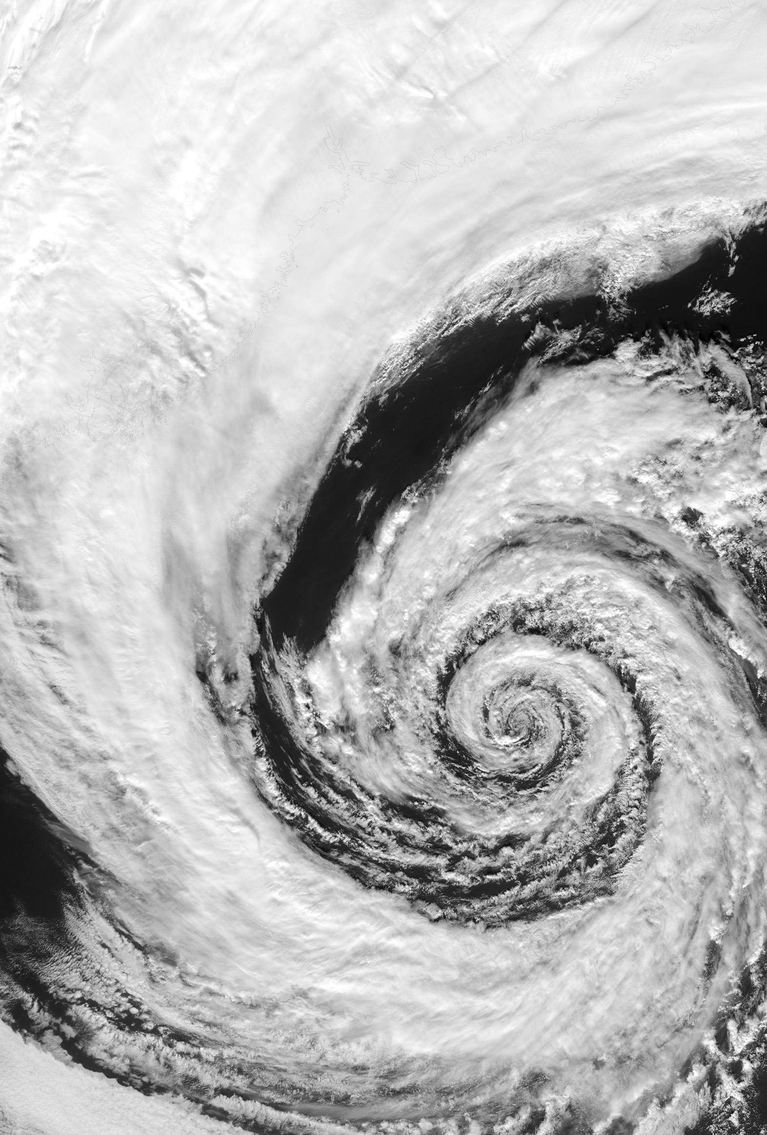
Design Instability
Universal Patterns of
Design Dynamics
Željko Obrenović
Erik Stolterman

Slide 2
Design
Instability
Notes on Design Complexity
Željko Obrenović
Erik Stolterman

